Slide 1
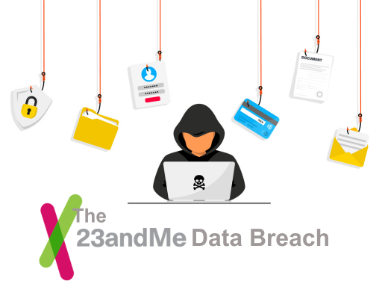

23andMe
Presented by: Ishan JAIN
Github account: ishannjain
Edx_username: Ishan_ishu
Location: Tikamgarh, Madhya pradesh , india
date of recording:3 March 2025

Slide 2
Introduction
The 23andMe data leak was a data breach at personal genomics company 23andMe reported in October 2023. The cyberattack gathered profile and ethnicity information from millions of users. The affected customers were reported as primarily Ashkenazi Jews but also including hundreds of thousands of ethnically Chinese users. The hacker(s) stole information customers had chosen to share with their DNA matches, which could include name, profile photo, birth year, location, family surnames, grandparents' birthplaces, ethnicity estimates, mitochondrial DNA haplogroup, Y-chromosome DNA haplogroup, link to external family tree, and any text content a customer had optionally included in their "About" section. On October 6, 2023, the company confirmed that the hacker(s) had illicitly accessed data on approximately 6.9 million users.

Slide 3
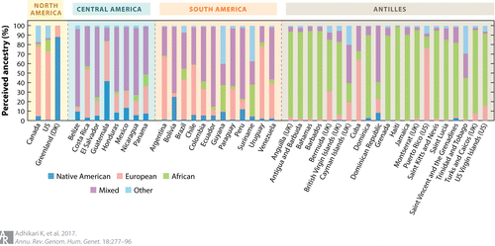
Data Leaked
Date of Breach: Discovered in October 2023.
Company Affected: 23andMe, a personal genomics and biotechnology company.
Users Impacted: Data from 6.9 million users was exposed.
Type of Data Leaked:
Full names
Profile photos
Birth years
Geographic locations
Genetic ancestry information
DNA Relatives data (used to connect users with genetic relatives)

Slide 4
Further Details
Attack Method:
Credential Stuffing: Hackers used previously leaked credentials from other breaches to access 23andMe accounts, exploiting users who reused passwords.
Exploitation of Platform Features:
Attackers leveraged the “DNA Relatives” feature to access not only the victim’s data but also the data of their genetic matches, exponentially increasing the data exposed.
Targeted Groups:
Data sets focusing on specific ethnic groups (e.g., Ashkenazi Jews and Chinese) were advertised on hacking forums.

Slide 5
Company Response and Legal Repercussions
Initial Action:
Investigation launched and third-party security experts engaged.
Temporary disabling of sensitive features like the chromosome browser and raw data downloads.
Legal Repercussions:
Affected users filed a class-action lawsuit.
In September 2024, 23andMe agreed to a $30 million settlement and offered 3 years of security
monitoring to impacted users.
Reputation Damage & Business Impact:
Company’s market value dropped from $3.5 billion to around $180.2 million.
Full Board Resignation: Seven independent board members resigned over disagreements with
CEO Anne Wojcicki’s plans to take the company private.
Massive Layoffs: In November 2024, 23andMe cut 40% of its workforce (~200 employees) and
ended development of its therapeutic programs.

Slide 6
Impact on the company
The data breach had profound implications for 23andMe's financial stability and corporate governance. The company's stock value plummeted, leading to a market capitalization of approximately $180.2 million, a significant decline from its previous valuation of $3.5 billion. In September 2024, all seven independent board members resigned due to strategic disagreements with CEO Anne Wojcicki's proposal to take the company private. Subsequently, in November 2024, 23andMe announced a 40% reduction in its workforce, amounting to 200 employees, and ceased further development of its therapeutic programs.

Slide 7
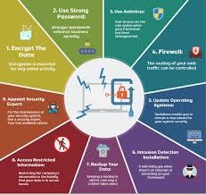
Preventive measures
Enforce Multi-Factor Authentication (MFA):
Require MFA to reduce reliance on passwords alone.
Monitor for Credential Stuffing Attacks:
Use tools that detect unusual login patterns and rapid failed attempts.
Promote Strong Password Hygiene:
Encourage users to use unique passwords and adopt password managers.
Limit Data Exposure in Features:
Ensure that features like “DNA Relatives” cannot inadvertently expose sensitive data.
Educate Users About Security:
Regularly inform users about phishing risks, password security, and the dangers of reusing credentials.
Implement Robust Incident Response Plans:
Have clear protocols in place for data breach detection, mitigation, and communication.

Slide 8

Conclusion
Even when direct hacking isn't involved, weak user practices
(like password reuse) can lead to devastating breaches.
Sensitive personal data—especially genetic information—requires
higher levels of protection and user education.
Reputation damage and legal consequences can be as harmful as the breach itself.

